Slide 1


Online Experiments for Language Scientists
Kenny Smith
kenny.smith@ed.ac.uk
These slides are based on Shira Tal & Kenny Smith, “A brief introduction to running artificial language learning experiments online”, Edinburgh Workshop on Artificial Language Learning, October 2021

Slide 2
This is mainly a pointer to other resources
These slides and code are available online for more leisurely perusal
https://github.com/kennysmithed/oels_emlar2023
Lots of more detailed materials on my Edinburgh undergrad/Masters course page!
2022 iteration: https://kennysmithed.github.io/oels2022/
Longer lecture slides, papers, detailed notes on crowdsourcing
Example code for linguistics experiments of various complexities
Linguistics undergrad/MSc students with little prior coding experience all produce a working experiment by the end of the course

Slide 3
Why run experiments online?
Pandemics!
Faster
Larger samples
Potentially more diverse populations (less WEIRD)
Access to specific populations

Slide 4
Challenges of doing online data collection
(For some of us) it’s new
Involves more components to take care of
(Could) involve more coding
Less control:
Who are the participants?
In what environment do they participate in the study?

Slide 5
Running experiments
Recruiting participants (for me, mainly adults)
Participants do the experiment

Slide 6

Running experiments in the lab
Various ways to recruit participants to come into the lab (SONA, advertising on campus…)
Programming environment to create the experiment (PsychoPy, Eprime…)
Supporting files & data are saved on the lab’s computer

Slide 7

Running experiments online
Participants are recruited to do experiments on their own devices
Programming environment to create the experiment (so it is presented on participants’ devices)
Supporting files & data are saved outside of participants’ devices

Slide 8
Running experiments online
Platforms to recruit and compensate participants (Prolific, Mechanical Turk…)
Programming environment to create the experiment (javascript, jsPsych, Gorilla…)
Server
(university or private server, Pavlovia, cognition.run, …)

Slide 9
Overview of this tutorial
Platforms to recruit and compensate participants (Prolific, Mechanical Turk…)
Programming environment to create the experiment (javascript, jsPsych, Gorilla…)
Server
(university or private server, Pavlovia, cognition.run, …)

Slide 10
Recruiting participants online
Notes:
Mainly adults, trickier with kids!

Slide 11

Crowdsourcing
Once you have an experiment that runs in a browser, you can get participants from anywhere, including crowdsourcing sites
Websites with populations of “workers” who will do online tasks for money

Slide 12


MTurk and Prolific
Amazon Mechanical Turk
https://www.mturk.com
Designed for crowdsourcing anything
Very light touch
More US-based participants?
Interface is pretty horrible (particularly for experimenter) but has a powerful API for code-based payment etc
More chaotic, worse data (or more need to restrict participation to established workers)?
Prolific (formerly “Prolific Academic”)
https://www.prolific.co
Designed for scientific data collection
Heavier vetting of participants
More UK/EU participants?
Nicer web interface, recently added an API (but I haven’t used it)
Maybe better-behaved participants
Notes:
Probably recommend prolific?

Slide 13
A look around Prolific
From a participant perspective
From an experimenter perspective

Slide 14
Recruiting children for online studies
We (actually it was Shira Tal) have done this precisely once!
Older kids (age 5-6) recruited through our participant pool
Zoom call with screen sharing and an experiment coded in jsPsych
Quick compared to lab data collection
There are crowdsourcing sites for child participants
https://childrenhelpingscience.com (now merged with lookit)
https://lookit.mit.edu (mainly preferential looking, using their own jsPsych-like framework)
Notes:
For older kids, I think a sufficiently well-designed experiment could be run by themselves, with parental help at the start

Slide 15
Pros and cons of crowdsourcing experimental data
Pros
Not face-to-face
Large samples, fast
Access different populations
+ for replicability
Cons
Expensive (not cheap)
Lack of control
Encourages dumb experiments?
- for replicability

Slide 16
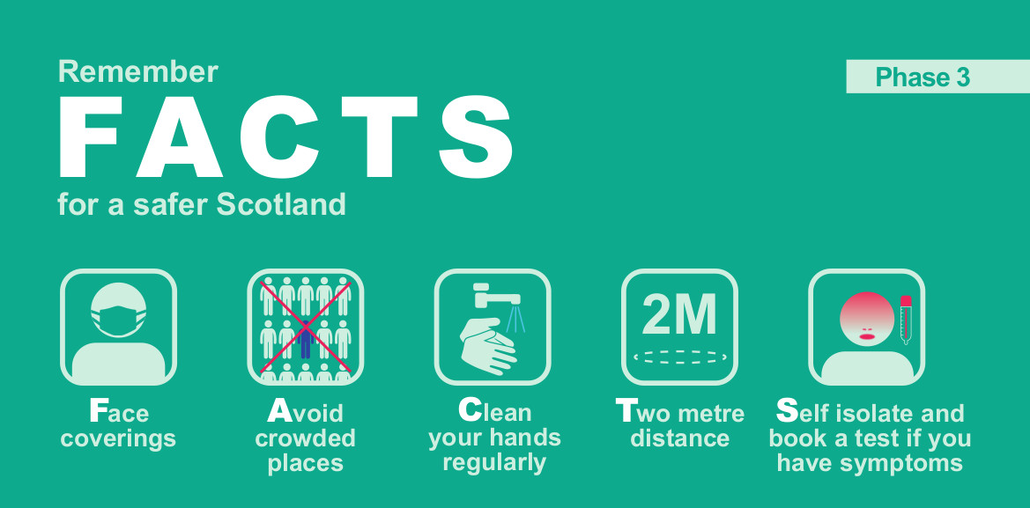
Pro: not face-to-face

Slide 17
Pro: large samples, fast
MTurk and Prolific both have large active populations of workers/participants (100,000s of registered people)
Although not everyone is active all the time
Estimating Mturk population size is complicated (see e.g. Difallah et al., 2018)
Prolific gives you an estimate of available and active population size
In practice, you can recruit 100s/1000s of participants in days.

Slide 18
Pro: access different populations
Typical lab-based studies will sample from university student population
Mostly undergraduates
Mostly young
All highly educated
In Edinburgh, mainly native English speakers (obviously varies between unis)
If you want to access a different population, crowdsourcing might let you do that
From Pavlick et al. (2014)
Notes:
No equivalent, as far as I can tell, in e.g. China

Slide 19
Pro: + for replicability
If you see a result in a scientific paper, can you assume that the effect they report is real and not just, e.g., a statistical fluke?
One way to check: replication
Take someone else’s experiment, replicate it, check you get the same result

Slide 20
From Open Science Collaboration, 2015, Science
Notes:
100 replication attempts from papers in 3 flagship journals, replications were high-power (i.e. low probability of type 2 error), care was taken to do a faithful replication (i.e. original authors were consulted)
Several things to note: nearly all originals were significant, many replications weren’t; almost no points lie above the diagonal (i.e. replication estimated bigger effect than original)

Slide 21
Pro: + for replicability
If you see a result in a scientific paper, can you assume that the effect they report is real and not just, e.g., a statistical fluke?
One way to check: replication
Take someone else’s experiment, replicate it, check you get the same result
Multiple potential advantages for online data collection
Because collecting a large sample is easy, small-sample experiments (which are more prone to statistical flukes) can be avoided
Because collecting data online is fast and easy, it makes it easier to replicate experiments (including your own!)
Because populations are shared, makes it easy to replicate closely (avoiding e.g. “ah it’s because your population is different” responses to non-replication)

Slide 22
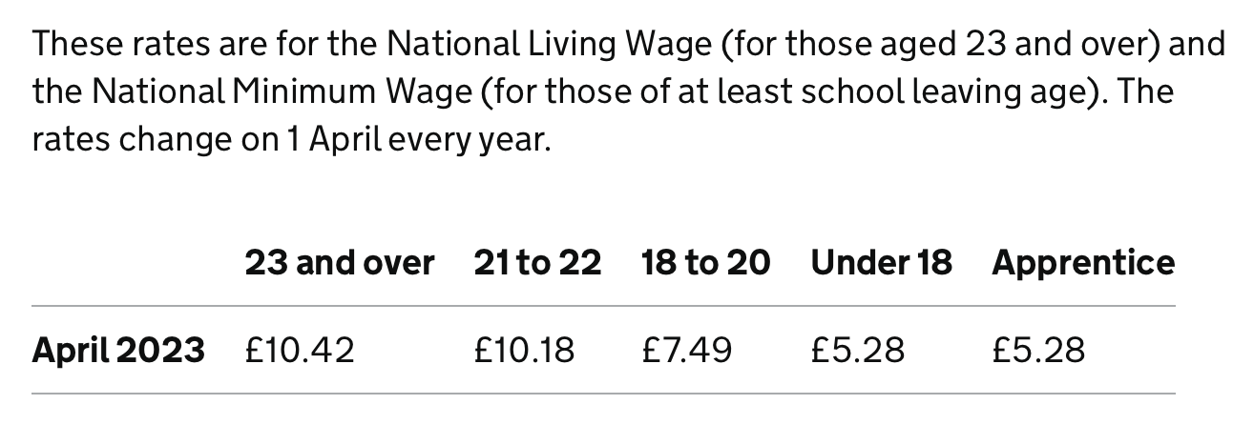
Con: expensive (not cheap)
Mturk does not set minimum pay rates
Prolific does, but they are low (£6/hour)
https://www.gov.uk/national-minimum-wage-rates

Slide 23
Con: expensive (not cheap)
Mturk does not set minimum pay rates
Prolific does, but they are low (£6/hour)
But we should not be paying at those rates
It’s unethical
It’s exploitative
Additionally
Mturk and Prolific charge fees: 20-40% on top of what goes to participant
Plus sample sizes tend to be bigger (because data quality can be lower or just because you can)

Slide 24

Some other quick remarks on your behaviour on crowdsourcing sites
Pay fairly
Test and test before putting your study up
If things break or take a lot longer than advertised, participants get stressed
Reject infrequently, if at all
Respond promptly and politely to questions, don’t get into arguments
If in doubt, pay out

Slide 25
Con: Lack of control
In a normal lab study
You interact with your participants when they arrive, and can see that they are indeed e.g. a sober human who speaks English natively
They take part in a quiet, controlled lab environment on a modern machine that behaves in a known way
You can monitor them as they participate, and they know this
With crowdsourced participants participating remotely, none of these things are true
Consequently, experiments need to be designed to handle this

Slide 26

Some ways to compensate for lack of control
Add checks on who the participants are: native language checks, instruction comprehension checks, …
Add attention checks during the task, identify (and eject?) people who are not attending or who are responding randomly
Can you make it easier to pay attention than not?
Make the experiment short and fun! Most tasks on these platforms are pretty dull.

Slide 27
Con: encourages dumb experiments (?)
No hard constraints, but because of the lack of control, stuff that works best involves constrained and low-effort responses
One-off decisions (i.e. not involving complex integration of info)
Few restricted choices per trial (not e.g. open-ended typing)
Short experiments (a few minutes rather than an hour)
Can you investigate the questions you want using these sorts of methods?

Slide 28
Con: - for replicability
If you see a result in a scientific paper, can you assume that the effect they report is real and not just, e.g., a statistical fluke?
Potential risk of online data collection: Because collecting data online is fast and easy, it makes it easier to run lots of experiments, and just publish the ones that “work” (cf. “the file drawer problem”)

Slide 29
Final note: Comparability with lab data
People often want to know if crowdsourced data is like lab data (i.e. do effects shown in the lab replicate online?)
Lab data as a “gold standard” due to higher levels of control
Or just because the effect you are interested in has only been shown in the lab
Effects of many paradigms first tested in the lab were replicated with crowdsourced populations (e.g., Monroe et al., 2010; Enochson & Culbertson, 2015; Loy & Smith, 2021; …)
Notes:
This topic covered in several of the option readings

Slide 30
Some other quick remarks on your behaviour on crowdsourcing sites
Pay fairly
Test and test before putting your study up
If things break or take a lot longer than advertised, participants get stressed
Reject infrequently, if at all
Respond promptly and politely to questions, don’t get into arguments
If in doubt, pay out

Slide 31
Building online experiments using javascript and jsPsych

Slide 32

Javascript and jsPsych
Javascript: a programming language that runs in web browsers
jsPsych: a library that makes it easy to build experiments (https://www.jspsych.org)
de Leeuw, J. R. (2015). jsPsych: A JavaScript library for creating behavioral experiments in a web browser. Behavior Research Methods, 47, 1-12. doi:10.3758/s13428-014-0458-y.
Josh de Leeuw
Vassar College

Slide 33
Resources for teaching yourself jsPsych
My course: https://kennysmithed.github.io/oels2022/
The main jsPsych webpage: https://www.jspsych.org
Josh de Leeuw’s tutorials at Moving Research Online workshop, 2020: https://www.movingresearchonline.info
jsPsych discussion forum on github: https://github.com/jspsych/jsPsych/discussions
Plus for general javascript help, googling until you find an answer you can use on StackOverflow!

Slide 34
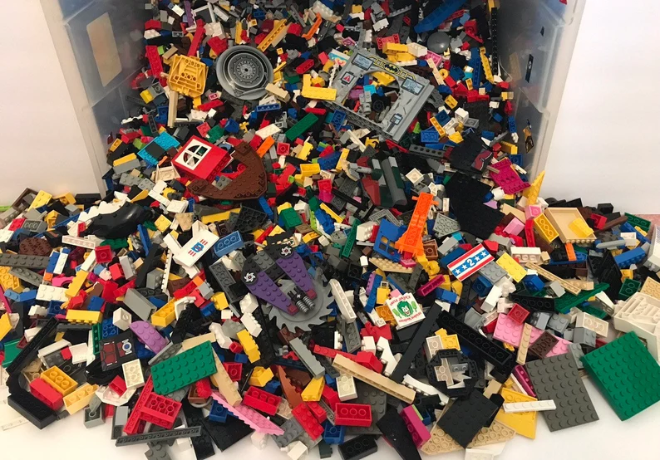
Notes:
Plugins and timelines

Slide 35
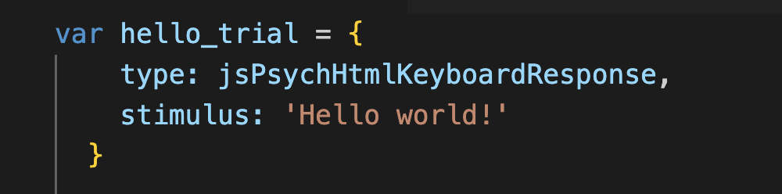
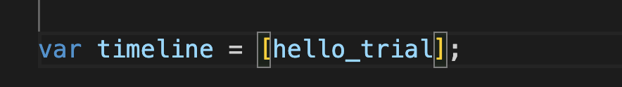
Plugins and timelines
Plugins: basic building blocks
Timeline: a sequence of those building blocks
Notes:
This is from the hello world example in the jsPsych starter tutorial

Slide 36
A wide range of plugins available
See https://www.jspsych.org/7.3/plugins/list-of-plugins/
Building an experiment involves
Knowing how to use plugins
Figuring out how to piece them together
Some tiny bits of html and javascript to connect the plugins and make them do what you want
(Occasionally, and optionally, making your own plugin)
Massive reuse of code within and across experiments!

Slide 37
Common components of experiments I build (usually artificial language learning tasks)
1. Consent and instructions
Minimally, some text + a button click
2. Training
Stimuli can be images, text, sounds
Entirely passive, or responses required to maintain engagement?
3. Test
Stimuli can be images, text, sounds
Responses required: button clicks, key presses, spoken responses
4. Demographics/additional info
Radio buttons, drop-down menus, numbers, free-text comments, …

Slide 38
A simple frequency-learning experiment
Ferdinand, V., Kirby, S., & Smith, K. (2019). The cognitive roots of regularization in language. Cognition, 184, 53-68.
Under what conditions do participants accurately track frequency distributions in their input, and when do they regularize (over-use frequent variants)?
Standard paradigm in the artificial language learning literature, e.g. Hudson Kam & Newport, 2005; Vouloumanos, 2008; Reali & Griffiths, 2009; Smith & Wonnacott, 2010; Culbertson et al., 2012; …
We were interested in effects of domain (linguistic vs non-linguistic stimuli) and demand (number of frequency distributions you have to track)

Slide 39
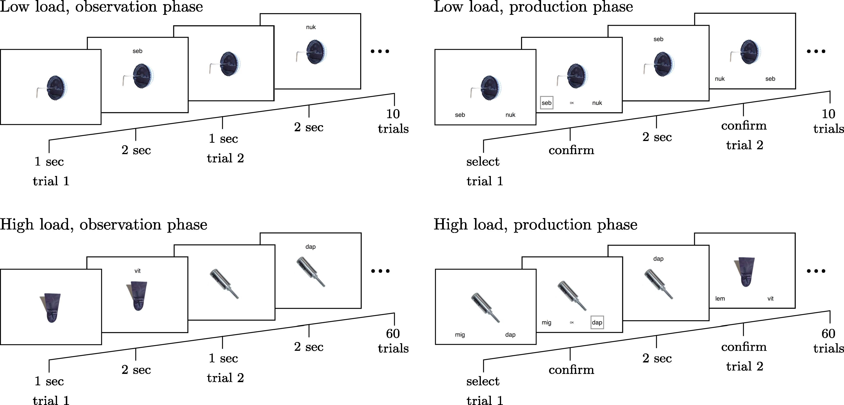
Notes:
I can see I have to present an image plus some text in observation trials. In production trials, I have to present an image plus two buttons. image-button-response plugin will allow me to do all of this.

Slide 41
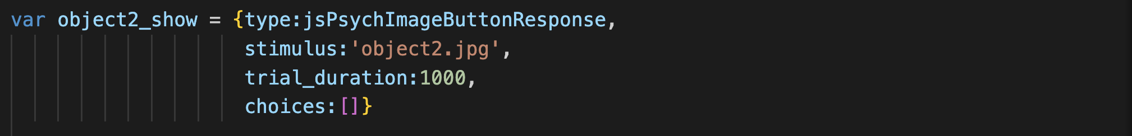
Using an image-button-response plugin to show image

Slide 42
This specific image is called object2.png

Slide 43
Show it for 1000ms

Slide 44
No response required!

Slide 45
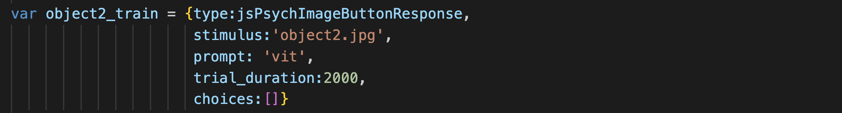
Using an image-button-response plugin to show image

Slide 46
This specific image is called object2.png

Slide 47
Show it along with label using the prompt parameter

Slide 48
Show it for 2000ms

Slide 49
No response required!

Slide 50
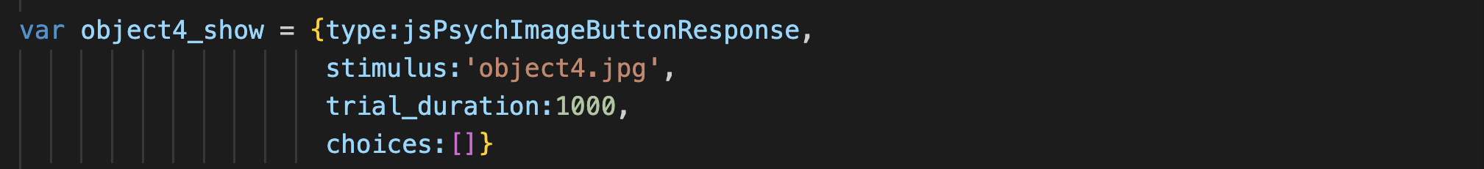
Show (different) image

Slide 51
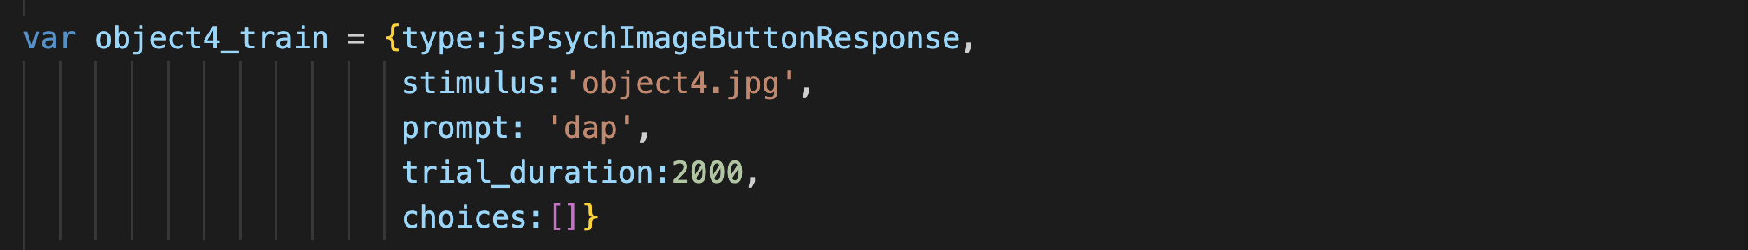
Show (different) image + label

Slide 52

String many trials together to form a timeline

Slide 53
Notes:
OK, so this is going to be the same idea, and I can already see that I can re-use something – the post-confirmation display phase is exactly like the labelling trials during training, so I can re-use code there. But now I will be adding in choices. And a tricky thing – what I show during the post-confirmation display will depend on what they clicked on - *contingent trials*, very typical in experiments involving any kind of feedback.

Slide 54

Using an image-button-response plugin to show image and get response

Slide 55
choices parameter contains labels for buttons

Slide 56
Note we no longer specify the trial duration: trial lasts until the participant responds

Slide 57
Confirm trial: going to do this slightly differently and make them click on a button showing the label they just selected

Slide 58
dap
Confirm trial: going to do this slightly differently and make them click on a button showing the label they just selected

Slide 59
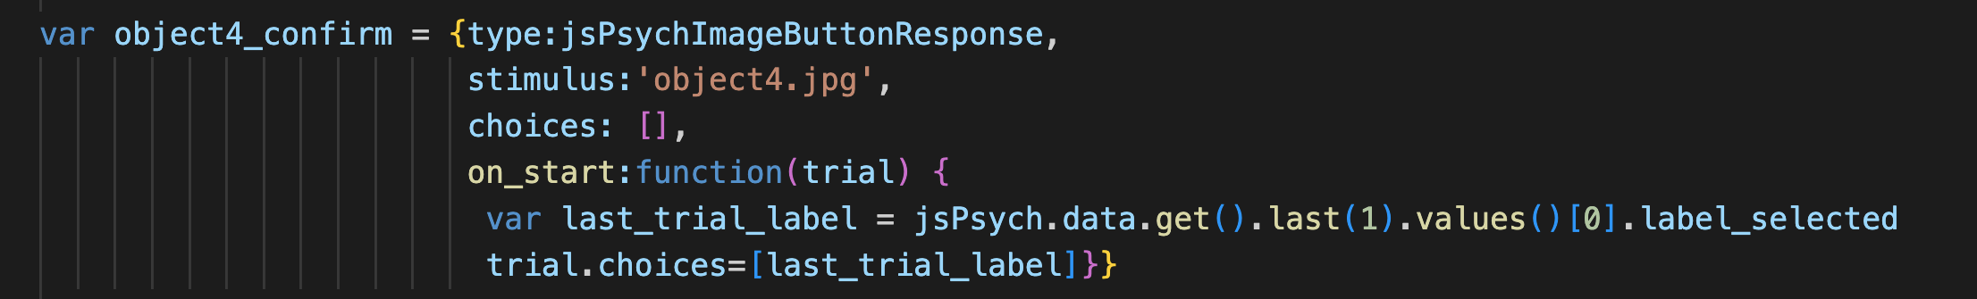
dap
When we build the timeline (i.e. when the experiment is loaded), we don’t know what the confirmation label will be!

Slide 60
dap
But by the time this trial starts, we can retrieve it…

Slide 61
dap
…by consulting the data generated by the immediately preceding trial

Slide 62
dap
That will be the label for our confirmation button

Slide 63
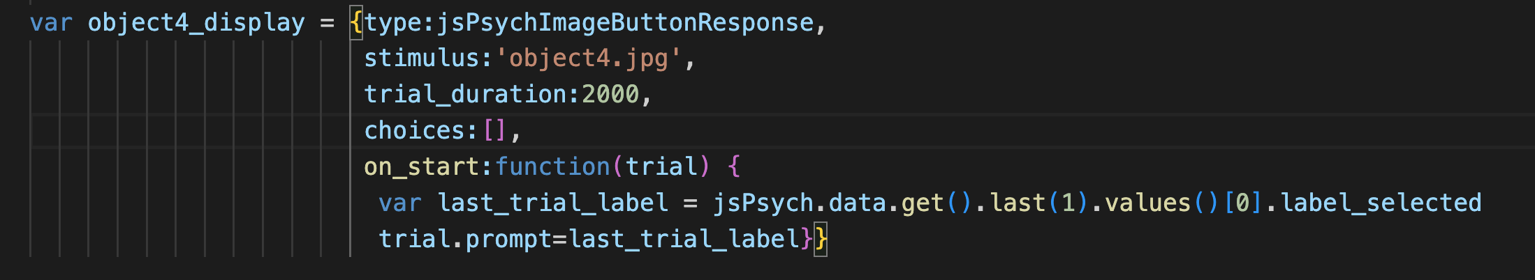
dap
Post-confirmation display looks like a training trial…

Slide 64
dap
…except we use the same trick to get the prompt from their previous trial response

Slide 66
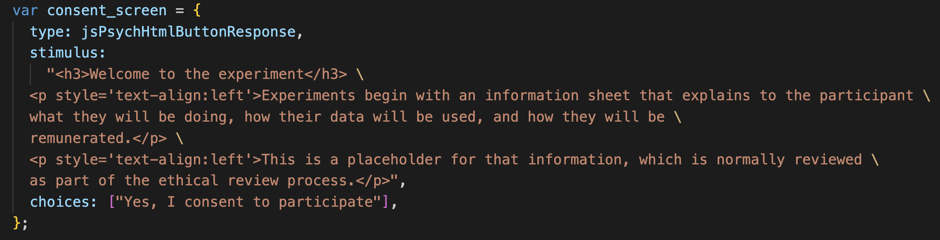
Using an html-button-response plugin to show formatted text and get them to click
Notes:
*definitely* going to need a consent screen

Slide 67
The “stimulus” is the text that will appear on the screen.
(I have added some formatting to make it look nice)

Slide 68
Here there is only one choice, which is to consent

Slide 70
survey-html-form allows you to collect various kinds
of responses on a single screen

Slide 71
Demo – ferdinand_etal_2019/fks19.html

Slide 72
An example involving audio stimuli and keyboard responses
Based on Gomez, R. L. & Gerken, L. (1999) Artificial grammar learning by 1-year-olds leads to specific and abstract knowledge. Cognition, 70, 109-135.
Can participants implicitly learn an underlying grammar from presentation of positive examples, and subsequently differentiate between strings generated by / not generated by that grammar?
Standard paradigm in the artificial grammar learning literature, e.g. Reber, 1967, 1989; Wilson et al., 2015; …
audio-keyboard-response plugin to present word sequences during training (NB no response required)
html-keyboard-response plugin to obtain yes/no responses on test trials

Slide 73
Demo – gomez_gerken_1999/gg99.html

Slide 74
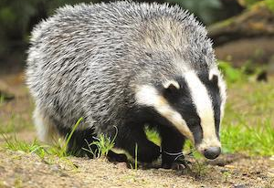


An unexpected challenge: multimodal stimuli
Based on Martin, A., & White, J. (2021) Vowel harmony and disharmony are not equivalent in learning. Linguistic Inquiry, 52, 227-239.
Do participants assume that vowels should be harmonic or disharmonic?
Click to listen
Notes:
Not as hard as it sounds – and you can also use this to make superficial changes, add extra text fields, make a 2-image plugin, etc

Slide 75
An unexpected challenge: multimodal stimuli
Previous examples were quite easy to achieve using existing plugins
But what if there isn’t a plugin that does exactly what you want? E.g. image and audio on a single trial
Two options:
Smuggle in images to the prompt on an audio-button-response trial, or smuggle in audio to the prompt on an image-button response trial
Edit the plugin to produce a custom plugin, e.g. an image-audio-button-response plugin!
Click to listen
Notes:
Not as hard as it sounds – and you can also use this to make superficial changes, add extra text fields, make a 2-image plugin, etc

Slide 76
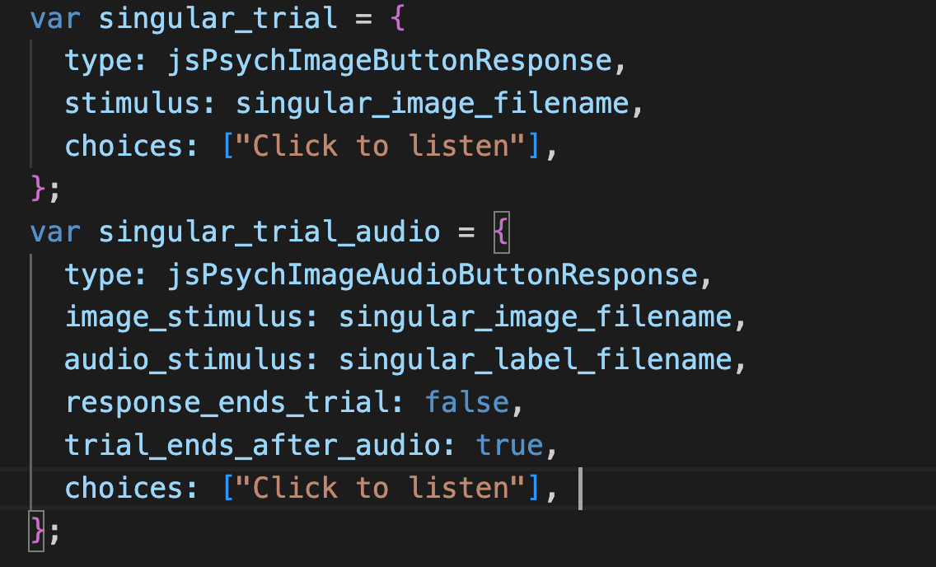
An unexpected challenge: multimodal stimuli
Click to listen
Notes:
Not as hard as it sounds – and you can also use this to make superficial changes, add extra text fields, make a 2-image plugin, etc

Slide 77
Demo – martin_white_2021/mw21.html

Slide 78
Additional things you will want to know how to do
Random assignment to conditions
Preloading stimuli
Saving data
Recording audio responses
Reading in trial lists
Contingent progression

Slide 79
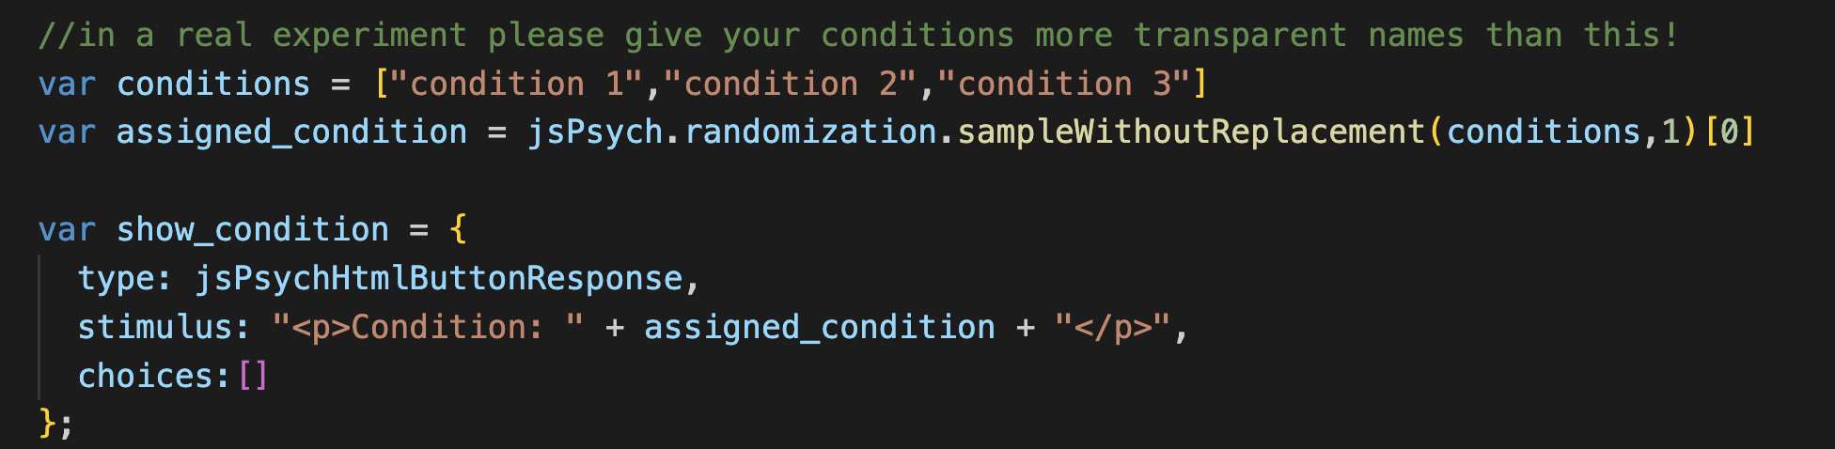
Random assignment to conditions

Slide 80
Demo – other_examples/random_assignment.html

Slide 81
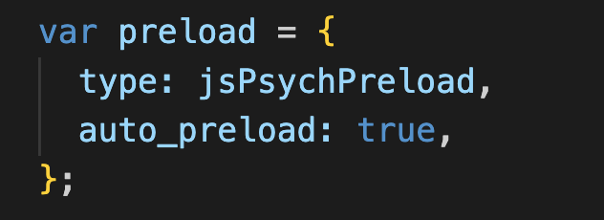
Preloading stimuli
Downloading images, sound files etc takes an unpredictable amount of time.
Trial durations ignore the time taken to download
And beware: if you are testing your code, your browser might already have loaded and cached the stimuli, so you won’t notice the lag
The solution: preloading
Requires you to use the preload plugin
Certain plugins mark parameters (e.g. stimuli) for automatic preloading by the preload plugin
You can add everything else to a manual preload list
See jsPsych pages on preloading: https://www.jspsych.org/7.3/overview/media-preloading/

Slide 82
Saving data
You need to save data on your server, not on the participant’s computer!
Requires a bit of extra infrastructure: PHP script to write data to server (and a server that can run PHP – you will need your tech people to set this up)
See e.g.
jsPsych pages on data: https://www.jspsych.org/7.3/overview/data/
Week 6+ of my course (e.g. https://kennysmithed.github.io/oels2022/oels_practical_wk6.html)
You can save data at the end of the experiment or after every trial
Do trial-by-trial if you can!

Slide 83
Recording audio responses
Accessing a participants’ microphone (and camera!) is quite straightforward
Although they have to approve, so you need to warn them you will request access
Recording audio data involves a little bit of extra work
Another PHP script to save the audio data to your server
See week 8 of my course: (https://kennysmithed.github.io/oels2022/oels_practical_wk8.html)
Or a
Audio quality varies, and sometimes the quality progressively degrades, but you get decent audio from 95% of participants

Slide 84
Reading in trial lists
I usually generate trial lists on the fly in the experiment code
e.g. using a jsPsych.randomization.repeat, or a for-loop
If you prefer to have the trial list in a separate file on the server, that’s possible too
Reading in CSV files is slightly tricky because it involves a delay in accessing a file on the server (you have to force the browser to wait until the trial list is loaded)
See weeks 8-10 of my course (https://kennysmithed.github.io/oels2022/oels_practical_wk8.html)

Slide 85
Contingent progression
Useful to be able to control who progresses beyond a certain point in your experiment
See https://www.jspsych.org/7.3/overview/timeline/#conditional-timelines
(Martin & White, 2021, p. 229-230)
Notes:
Show them the conditionals example

Slide 86
Demo – other_examples/contingent_progression.html

Slide 87
Other platforms are available!
Flexible
Inflexible
Qualtrics
Gorilla
Psychopy3
Raw
javascript
jsPsych
Difficult
Easy

Slide 88
References

Slide 89
Difallah, D., Filatova, E., & Ipeirotis, P. (2018). Demographics and Dynamics of Mechanical Turk Workers. In Proceedings of WSDM 2018: The Eleventh ACM International Conference on Web Search and Data Mining. https://doi.org/10.1145/3159652.3159661

